Slide 1
MapReduce (Jeffrey Dean and Sanjay Ghemawat, OSDI ‘04)
CS 5540 (Rao)

Slide 2
Introduction (1/2)
MapReduce is a
programming model and
implementation for processing and generating large data sets
Introduced by Google, draws inspiration from functional languages
A task is broken down into processing key-value pairs
Users will specify a map function and a reduce function

Slide 3
Introduction (2/2)
Can run a MapReduce program on large number of commodity machines
Terabytes of data can be processed on thousands of machines (Google!)
Easy for a programmer to specify parallelism for data intensive tasks
Open source implementation of MapReduce is available
Hadoop (Java based), Phoenix (shared-memory, C based), Disco (Erlang/Python), Spark, and some more

Slide 4
Illustration
Intermediate
data
output
data
map
reduce
data
map
reduce
data
map
reduce
data
map

Slide 5
Map Function
Creates a set of key-value pairs from the input data
The input data is partitioned and the Map function is run over each partition
Prototype
map (k1,v1) → list(k2,v2)

Slide 6
Example (Word Count)
map(String key, String value) :
// key: document name
// value: document contents
for each word w in value:
EmitIntermediate (w, “1”);
Notes:
See board

Slide 7
Reduce Function
The set of intermediate key-value pairs generated by Map functions are merged
All values that share the same key are collected
Requires sorting
The Reduce function accepts an intermediate key and a list of values associated with it
A user defines how the list of values should be processed
Usually produces zero or one output value
Prototype
Reduce (k2, list(v2)) → list(v3)

Slide 8
Example (Word Count)
reduce (String key, Iterator values) :
// key: a word
// values: a list of counts
int result = 0;
for each v in values:
result += ParseInt (v);
Emit (AsString (result));

Slide 9
More examples
Distributed Grep
Map → emits a line if it matches a supplied pattern
Reduce → identity function
Count of URL access frequency
Map → processes logs of web page requests, and emits <URL,1>
Reduce → Adds all the values for the same URL and emits <URL, total count>

Slide 10
More examples…
Inverted Index
Map → parses each document and emits a sequence of <word, document ID>
Reduce → gets a list of document IDs for the same word, sorts this list of docIDs, and emits <word, sortedlist(docIDs)>
See other examples in the paper (Section 2)
http://labs.google.com/papers/mapreduce-osdi04.pdf

Slide 11
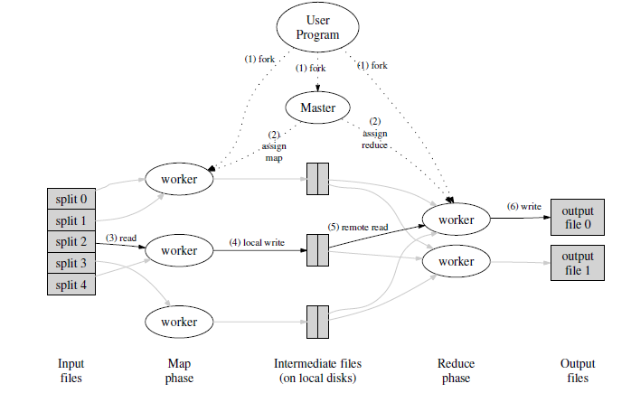
Execution Overview
Intermediate keys are partitioned into R pieces
e.g., hash(key) mod R
Input split into M pieces
Notes:
Sorting happens when storing locally – then the final sort can be a merge sort at the reduce worker

Slide 12
Steps Involved (1/2)
Input file is split into M pieces
Many instances of the user program are forked
One of them is special called the Master, the rest are Workers
There are M map tasks and R reduce tasks
Master assigns a task to an idle worker
A worker assigned a map task reads the corresponding input split and generates intermediate key-value pairs
First writes to a buffer, then periodically flushes it to disk, partitioned into R pieces
Notes:
# of workers assigned to Map will decide how many intermediate files are generated – each file contains R partitions/pieces
# of output files equals number of workers assigned to the reduce phase

Slide 13
Steps Involved (2/2)
The location of this intermediate data is passed to Master who can forward it to a Worker performing a reduce task
A reduce Worker uses RPC to read the intermediate data generated by map Workers for that specific reduce partition
When all intermediate data is read by a reduce Worker, it sorts the keys – all identical keys are grouped together
For each group (same key), it invokes the user defined Reduce function
Output is written to a separate file used by this Worker
Notes:
Sorting of intermediate K-V pairs can speed up final sorting

Slide 14
Questions?
http://labs.google.com/papers/mapreduce-osdi04.pdf

